Slide 1
Negotiation-based capacity planning with learning mechanism between factories in decentralized manufacturing environment
Presented by :
Aulia Rahman mufti fikri
(M10401816)

Slide 2
Background
Recently, there are more and more impacts of information technologies on the material processes in collaborative supply network. That is why it becomes a timely and crucial topic to consider supply networks as collaborative cyber-physical systems (Sokolov and Ivanov, 2015).
Cyber-physical systems are characterized by decentralization and autonomous behavior of their elements. They incorporate elements from both information and material (Physical) subsystems and processes (Zhuge, 2011).

Slide 3
Background
Most of the new factory concepts and supply networks on the cyber-physical principles share attributes of smart networking (Ivanov, Sokolov, and Kaeschel, 2010). Therefore, smart factories Industry 4.0 on the basis of collaborative cyber-physical systems represent a future form of industrial networks.

Slide 4
Background
Industry 4.0 represents a smart manufacturing networking concept where machines and products interact with each other without human control. By this concern, the automated systems that able to provide the interactions, such like negotiations among several parties, is highly required to maintain the processes.

Slide 5
Industry 4.0 represents paradigm shift
Centralized production
*Process the product
Decentralized production
*The product communicates with the machinery

Slide 6
Background
In decentralized manufacturing environment with multiple factories that are scattered geographically, the complexity of production systems increases, and capacity planning and allocation of resources have become a significant concern that affects system performances

Slide 7
Background
However, profit-oriented attitudes make individual factory planners to acquire maximal resources from their headquarters by taking advantage of peer factories. Imbalances in budget allocation will harm the overall performance of a firm.
Thus, autonomous negotiation process among factories for the best budget and resource allocation is highly imperative

Slide 8
Research purpose and objectives
This study will focus on the development of an integrated framework to allocate limited budget in a multiple-factory manufacturing environment
We will develop a negotiation framework with learning mechanism to allocate autonomously finite budget provided by a headquarters and to facilitate the use of limited manufacturing resources that are scattered over individual factories.

Slide 9
Research purpose and objectives
During negotiations, a factory exchanges a series of messages with the others and, then, applies negotiation functions to simulate the negotiation attitudes and tactics of a factory
Each factory will use a local capacity-planning model and a corresponding algorithm, both being deployed under the proposed negotiation framework

Slide 10


Negotiation framework
Orders
Resources
Orders
Resources
Factory 1
Factory 2
Negotiation
Budget
Resource portfolio
Task allocation
Budget
Resource portfolio
Task allocation

Slide 11
Negotiation decision function (NDF)
Negotiation is a process in which a joint decision is made by two or more parties which have individual and confronting objectives. The parties first express contradictory demands and then move towards an agreement by a process of making concessions and offering new alternatives.
The NDF is a framework of multi-lateral negotiation, which is derived from bilateral negotiation functions (Raiffa, 1982), and was first proposed by Faratin et al. (1998).

Slide 12
Negotiation decision function (NDF)
The functions employ a rating concept to conduct negotiation and support many parties and many issues in the negotiation.
In the NDF’s terminology,
  the agents involved are called parties
  the subjects to be bargained over are called issues, such as product price, quantity, and due date
  the sequence of offers and counter-offers in a two-party negotiation is called a negotiation thread

Slide 13
Negotiation process
Factory 1 starts negotiation by proposing a budget allocation plan and generating a local resource-investment and capacity-allocation plan with resulting potential profit by a factory-level capacity-planning model. Factory 1, then, sends the budget-allocation plan as an offer to its peer factory.
Factory 2 accepts the budget-allocation plan if the potential profit of the received offer is better than the local generated one. Otherwise, a counter budget-allocation plan is formed and sent to Factory 1

Slide 14
Negotiation procedure
This procedure can be completed in finite time when either a predefined negotiation time or a deal among factories is reached.

Slide 15
Step 1
The negotiation starter, say Factory 1, generates an offer (i.e., the budget in real number) by using NDF-based negotiation tactics

Slide 16
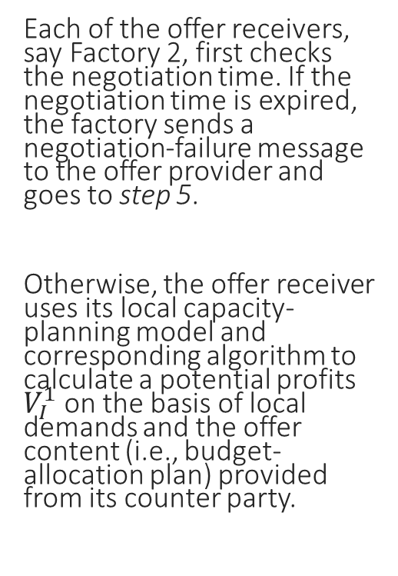
Step 2
Each of the offer receivers, say Factory 2, first checks the negotiation time. If the negotiation time is expired, the factory sends a negotiation-failure message to the offer provider and goes to step 5.
Otherwise, the offer receiver uses its local capacity-planning model and corresponding algorithm to calculate a potential profits $V_{I}^{1}$ on the basis of local demands and the offer content (i.e., budget-allocation plan) provided from its counter party.

Slide 17
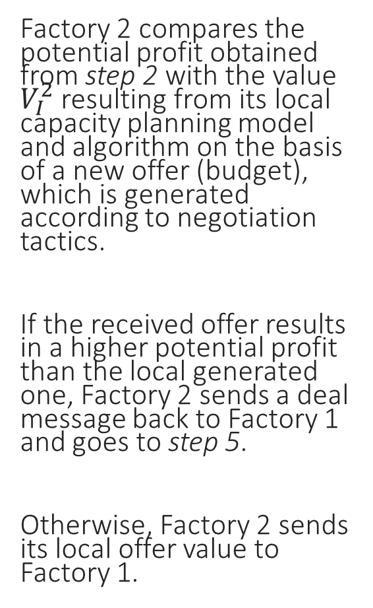
Step 3
Factory 2 compares the potential profit obtained from step 2 with the value $V_{I}^{2}$ resulting from its local capacity planning model and algorithm on the basis of a new offer (budget), which is generated according to negotiation tactics.
If the received offer results in a higher potential profit than the local generated one, Factory 2 sends a deal message back to Factory 1 and goes to step 5.
Otherwise, Factory 2 sends its local offer value to Factory 1.

Slide 18
Step 4
After receiving the offer from Factory 2, Factory 1 conducts the same procedure as step 2 and step 3.

Slide 19
Step 5
Negotiations are over, and the budget plan is output.
Once the compromised version of the budget-allocation plan is obtained after a negotiation process, each factory can develop its resulting resource-investment portfolio and capacity-allocation plan.

Slide 20
Negotiation decision functions
The Negotiation Decision Functions (NDF) is applied to a to represent negotiation attitudes of negotiators. It is composed of the following factors:
Parties: One side of the negotiators, i.e. agent.
Issue: Subject of the negotiation, ex: price or quantity.
Offer/Counter Offer: Offer value is the opinion proposed by the agent against the issue
  of negotiation.

Slide 21
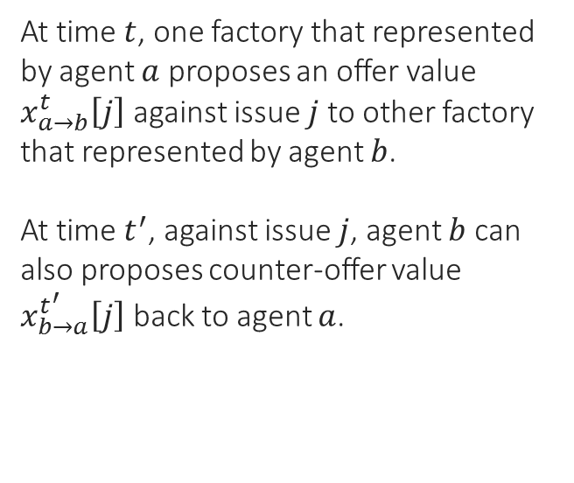
Negotiation decision functions
At time $t$, one factory that represented by agent $a$ proposes an offer value $x_{a→b}^{t}\left[j\right]$ against issue $j$ to other factory that represented by agent $b$.
At time $t^{′}$, against issue $j$, agent $b$ can also proposes counter-offer value $x_{b→a}^{t^{′}}\left[j\right]$ back to agent $a$.
When generating the counter-offer, agent can combine many different tactics to calculate the value, and negotiation strategy is utilized to decide how to combine these different tactics.
Faratin et al. (1998) developed three areas of tactics based on multilateral negotiation functions :
Negotiation Strategies
Time Dependent Tactics | Resource Dependent Tactics | Behavior Dependent Tactics
Boulware Tactics Conceder Tactics | Dynamic Deadline Tactics Resource Estimation Tactics | Relative Tit-For-Tat Tactics Random Tit-For-Tat Tactics Average Tit-For-Tat Tactics Utility tit-for-tat
Multilateral Negotiation Functions

Slide 22
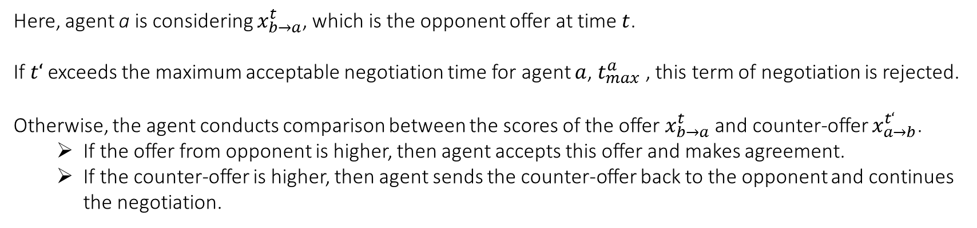
Negotiation decision functions
The function used by agent to judge the opponent offer and determine the next step are:
Here, agent a is considering $x_{b→a}^{t}$, which is the opponent offer at time $t$.
If $t‘$ exceeds the maximum acceptable negotiation time for agent $a$, $t_{max}^{a}$ , this term of negotiation is rejected.
Otherwise, the agent conducts comparison between the scores of the offer $x_{b→a}^{t}$ and counter-offer $x_{a→b}^{t‘}$.
  If the offer from opponent is higher, then agent accepts this offer and makes agreement.
  If the counter-offer is higher, then agent sends the counter-offer back to the opponent and continues the negotiation.

Slide 23
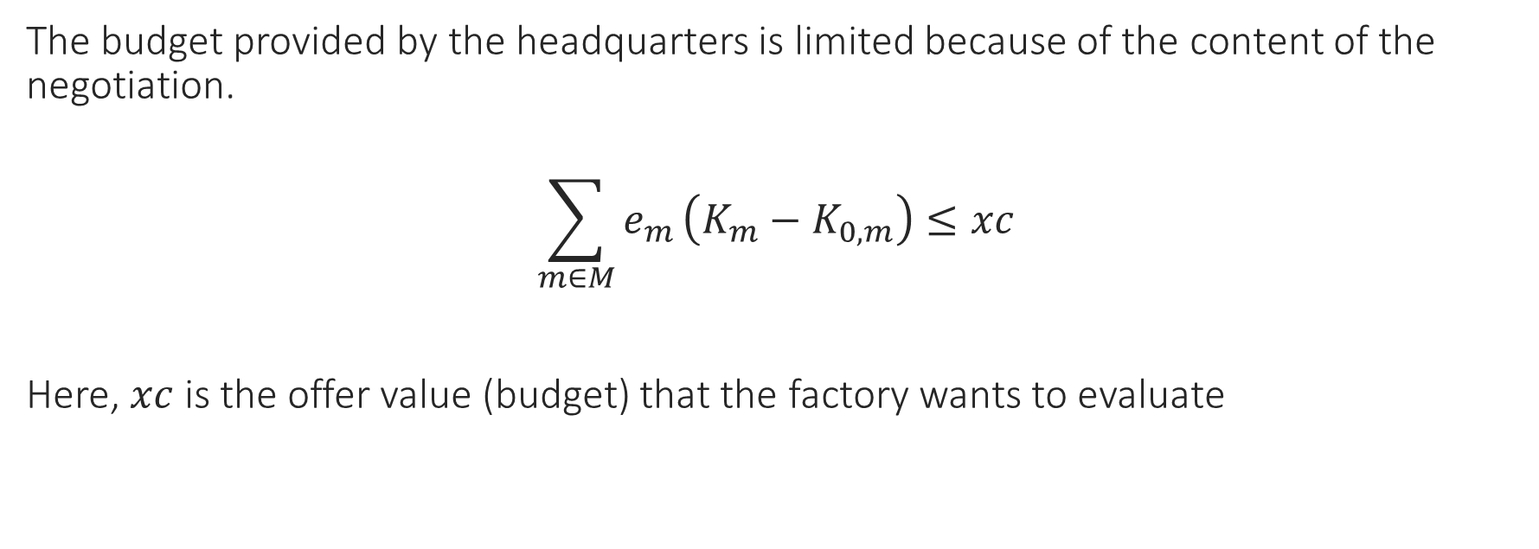
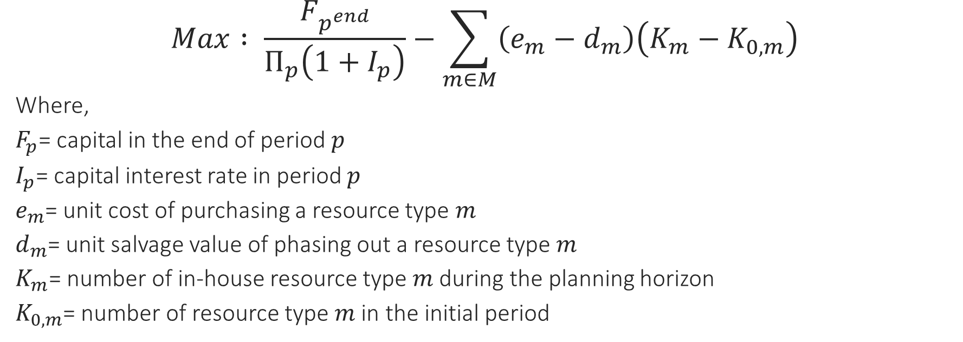
Negotiation decision functions
The scoring function is determined by
$$V^{i}\left(x\right)=\sum_{1≤j≤n}{w_{j}^{i}}V_{j}^{i}\left(x_{j}\right) , i∈\left\{a,b\right\}, j∈\left\{1, 2, …, n\right\}$$
where $w_{j}^{i}$ is the weight of agent $i$ against issue $j$, because each agent has different consideration of each issue, and
with $x_{j}^{i}∈\left[\min_{j}^{i},\max_{j}^{i}\right]$ means the acceptable value range for agent $i$ against issue $j$.

Slide 24
Local Capacity planning model
The capacity-planning model and corresponding algorithm for an individual factory is used in two situations:
  1) Calculate the potential profit under the proposed offer (budget allocation plan) based on the local resources and demands; and
  2) evaluate if the received offer sent by peer factory is acceptable.
The current study will use the individual-factory resource-planning and capacity-allocation model based on (Wang, K.J, and Wang, S.M., 2012) and adds to it a budget constraint to evaluate the potential benefit of the proposed offer, as well as to determine whether a received offer should be accepted.

Slide 25

Objective function
$$Max : \frac{F_{p^{end}}}{Π_{p}\left(1+I_{p}\right)}−\sum_{m∈M}{\left(e_{m}−d_{m}\right)\left(K_{m}−K_{0,m}\right)}$$
Where,
$F_{p}$= capital in the end of period $p$
$I_{p}$= capital interest rate in period $p$
$e_{m}$= unit cost of purchasing a resource type $m$
$d_{m}$= unit salvage value of phasing out a resource type $m$
$K_{m}$= number of in-house resource type $m$ during the planning horizon
$K_{0,m}$= number of resource type $m$ in the initial period
Here, the potential profits are calculated by profits from period
1 to period $p^{end}$,
which is equivalent to sum of the net present value of equipment salvage and the residual budget in period $p^{end}$

Slide 26
Constraint 1 : Limited budget of negotiation
The budget provided by the headquarters is limited because of the content of the negotiation.
$$\sum_{m∈M}{e_{m}}\left(K_{m}−K_{0,m}\right)≤xc$$
Here, $xc$ is the offer value (budget) that the factory wants to evaluate

Slide 27
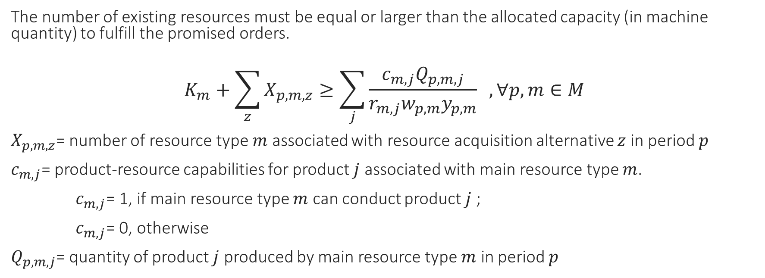
Constraint 2 : required number of resources
The number of existing resources must be equal or larger than the allocated capacity (in machine quantity) to fulfill the promised orders.
$$K_{m}+\sum_{z}{X_{p,m,z}}≥\sum_{j}{\frac{c_{m,j}Q_{p,m,j}}{r_{m,j}w_{p,m}y_{p,m}}} , ∀p, m∈M$$
$X_{p,m,z}$= number of resource type $m$ associated with resource acquisition alternative $z$ in period $p$
$c_{m,j}$= product-resource capabilities for product $j$ associated with main resource type $m$.
$c_{m,j}$= 1, if main resource type $m$ can conduct product $j$ ;
$c_{m,j}$= 0, otherwise
$Q_{p,m,j}$= quantity of product $j$ produced by main resource type $m$ in period $p$

Slide 28
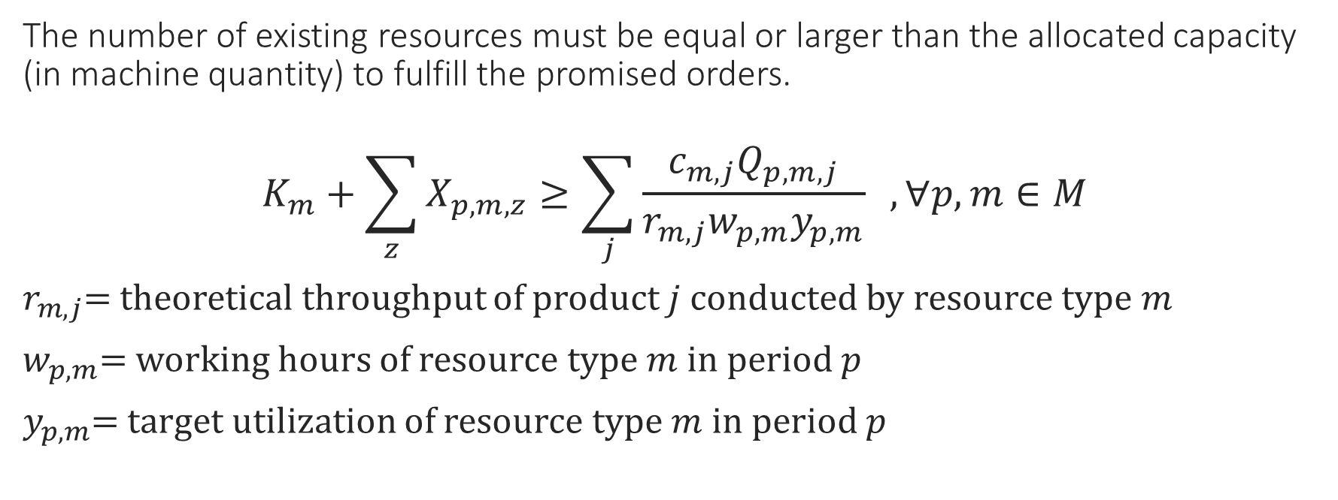
Constraint 2 : required number of resources
The number of existing resources must be equal or larger than the allocated capacity (in machine quantity) to fulfill the promised orders.
$$K_{m}+\sum_{z}{X_{p,m,z}}≥\sum_{j}{\frac{c_{m,j}Q_{p,m,j}}{r_{m,j}w_{p,m}y_{p,m}}} , ∀p, m∈M$$
$r_{m,j}$= theoretical throughput of product $j$ conducted by resource type $m$
$w_{p,m}$= working hours of resource type $m$ in period $p$
$y_{p,m}$= target utilization of resource type $m$ in period $p$

Slide 29
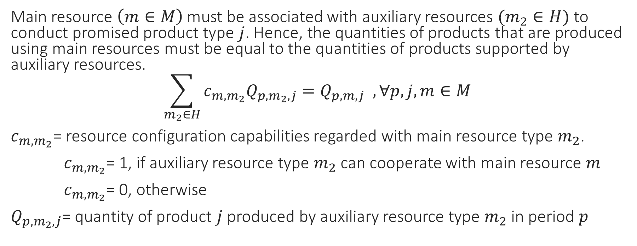
Constraint 3 : configuration constraints among resources
Main resource $\left(m∈M\right)$ must be associated with auxiliary resources $(m_{2}∈H)$ to conduct promised product type $j$. Hence, the quantities of products that are produced using main resources must be equal to the quantities of products supported by auxiliary resources.
$$\sum_{m_{2}∈H}{c_{m,m_{2}}Q_{p,m_{2},j}}=Q_{p,m,j} , ∀p,j,m∈M$$
$c_{m,m_{2}}$= resource configuration capabilities regarded with main resource type $m_{2}$.
$c_{m,m_{2}}$= 1, if auxiliary resource type $m_{2}$ can cooperate with main resource $m$
$c_{m,m_{2}}$= 0, otherwise
$Q_{p,m_{2},j}$= quantity of product $j$ produced by auxiliary resource type $m_{2}$ in period $p$

Slide 30

Constraint 4 : production balance from market demand
Treats demand type make to order (MTO)
$$\sum_{m∈M}{c_{m,j }Q_{p,m,j}}=o_{p,j}$$
Where, $j∈MTO$
$o_{p,j}$= market demands for product $j$ in period $p$

Slide 31
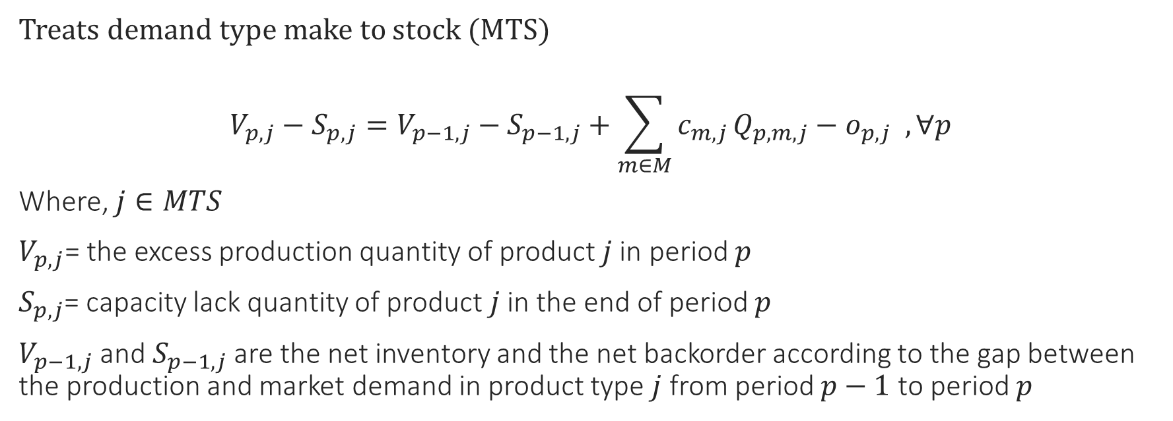
Constraint 5 : inventory balance from market demand
Treats demand type make to stock (MTS)
$$V_{p,j}−S_{p,j}=V_{p−1,j}−S_{p−1,j}+\sum_{m∈M}{c_{m,j }Q_{p,m,j}}−o_{p,j} , ∀p$$
Where, $j∈MTS$
$V_{p,j}$= the excess production quantity of product $j$ in period $p$
$S_{p,j}$= capacity lack quantity of product $j$ in the end of period $p$
$V_{p−1,j}$ and $S_{p−1,j}$ are the net inventory and the net backorder according to the gap between the production and market demand in product type $j$ from period $p−1$ to period $p$

Slide 32
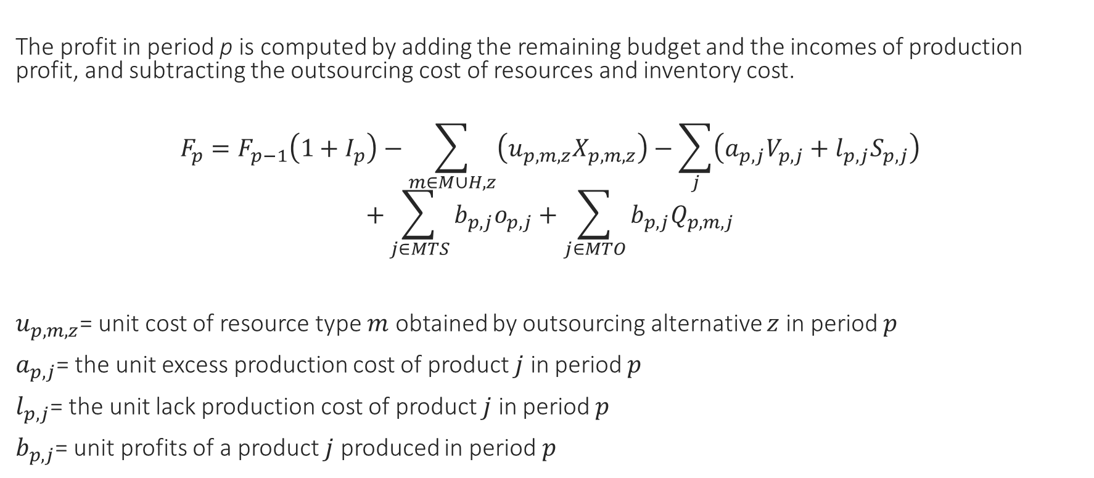
Constraint 6 : profit balance equation
The profit in period p is computed by adding the remaining budget and the incomes of production profit, and subtracting the outsourcing cost of resources and inventory cost.
$$F_{p}=F_{p−1}\left(1+I_{p}\right)−\sum_{m∈M∪H,z}{\left(u_{p,m,z}X_{p,m,z}\right)}−\sum_{j}{\left(a_{p,j}V_{p,j}+l_{p,j}S_{p,j}\right)}$$
$$+\sum_{j∈MTS}{b_{p,j}o_{p,j}}+\sum_{j∈MTO}{b_{p,j}Q_{p,m,j}}$$
$u_{p,m,z}$= unit cost of resource type $m$ obtained by outsourcing alternative $z$ in period $p$
$a_{p,j}$= the unit excess production cost of product $j$ in period $p$
$l_{p,j}$= the unit lack production cost of product $j$ in period $p$
$b_{p,j}$= unit profits of a product $j$ produced in period $p$

Slide 33
Next agenda :
Solving local capacity planning model

Slide 34
References
Sokolov, B., and Ivanov, D. (2015). Integrated Scheduling of Material Flows and Information Services in Industry 4.0 Supply Networks. International Federation of Automatic Control (IFAC)-PaperOnLine, 48-3, 1533-1538.
Zhuge, H. (2011). Semantic Linking through Spaces for Cyber-physical-socio Intelligence: A Methodology. Artificial Intelligence, 175 (5-6), 988-1019.
Ivanov, D., Sokolov, B., and Kaeschel, J. (2010). A Multi-structural Framework for Adaptive Supply Chain Planning and Operations with Structure Dynamics Considerations. European Journal of Operational Research, 200, 409-420.
Faratin, P., Sierra, C., and Jennings, N.R. (1998). Negotiations Decisions Functions for Autonomous Agents. Robotics and Autonomous Systems, 24(3-4), 159-182.
Raiffa, H. (1982). The Art and Science of Negotiation. Cambridge, MA: Harvard University Press
Wang, K.J. and Wang, S.M. (2012). A Negotiation-based Capacity Planning Model. IEEE Transactions on Systems, Man, and Cybernetics – Part C : Applications and Reviews, Vol. 42, No. 6.

