Slide 1
Notes:
The supply chain group has been tackling with capacity planning problem under demand uncertainty in different type of industry, with multiple resources and technologies.
Recently, although the rapid growth of technology has been bringing tremendous improvements for industry, but on the other side, the velocity of technology replacement and obsolescence also increases at the same time. For instance, the semiconductor manufacturing industry is known as capital and technology intensive. The industry experiences fast-paced developments in technology. Therefore, it requires to evaluate their current resources, schedule for technology introduction before investing a new technology.

Slide 2
Mathematical model-problem formulation
Product 1
Product 2
Product 3
Possible technologies
Combination of technologies
in each period
Production quantity
Notes:
Above is the technology portfolio adoption model considering capacity planning under demand and technological uncertainty. Assuming that the firm is manufacturing 2 types of products by using the technology 1 in the initial period, and there are another 2 new technologies, technology 2 and technology 3 respectively, sequentially introduced into the market with some probabilities.

Slide 3
Mathematical model-MDP
Stage : period of time(t=0,1,…,T)
State : (i,kj,t)
i : technology type
kj,t : Available capacity
Action : n
N=T-t : # of Available actions at each state
Transition probability :
t = 1
t = 2
t = 3
t = 4
$P_{t}=\left(s_{t+n} | s_{t},a_{t}\right)=P_{t}\left(i_{t+n},k_{j,t+n} | i_{t},k_{j,t},a_{t}\right)$=
$$=P_{t}\left(i_{t+n}, | i_{t},a_{t}\right)∗P_{t}\left(k_{j,t+n} | k_{j,t}\right)$$
Notes:
The decision of selecting the optimal portfolio of technologies is modeled as a Markov decision process (MDP)
Stage: Each period of time (t=0, 1, …, T);
State: Defined as$s_{t}=(i,k_{j,t})∈S$ which is a possible state at stage t.$i$ is the latest technology emerged in market, given that technology $(i−1)$ already appeared in period $(t−1)$
Action: Defined as $a_{t}=n$, which is the number of periods of time that the current technology portfolio should be used in production
Transition probability: Assuming that the state transition probability of technological changes and available number of machines are independent of each other

Slide 4
Solving method-DEPSO
Notes:
DEPSO starts with initialization in which the initial population, with size Z, is generated. Second, it will be followed by DE operations where crossover, mutation and infeasible repairing mechanism will be performed. The role of DE is to create a high level of diversity of the DE-PSO algorithm. Third, we will select n number of best solutions achieved from the DE operation. Each of these points is considered as a G-best point. Given each G-best point, PSO algorithm will perform and generate one new population. Therefore, we will have totally n new populations. The next step is updating new population where we will select Z number of best solutions from n population that have just generated by PSO. Finally, if one of stopping conditions is satisfied, the algorithm will be stopped. Otherwise, the new population will be sent to the DE, and the DE-PSO operation will be repeated. The pseudo code of the sampling based DE-PSO is described in the Figure 5.

Slide 5
Solving method-repairing mechanism
The detail description of the repairing mechanism is developed in the technology portfolio model. The three constraints will be checked and repaired sequentially. In the boundary repairing mechanism, the violated elements will be replaced by new elements which are generated between their boundaries. The second repairing mechanism involves in the production balance constraint. If the produce quantity of each product type excess demand, it will be reduced to demand. Finally, in the required number of machines repairing mechanism, if the allocated capacity is higher than available capacity (in machine number), the algorithm will increase the value of rented machines until the constraint is satisfied.

Slide 6
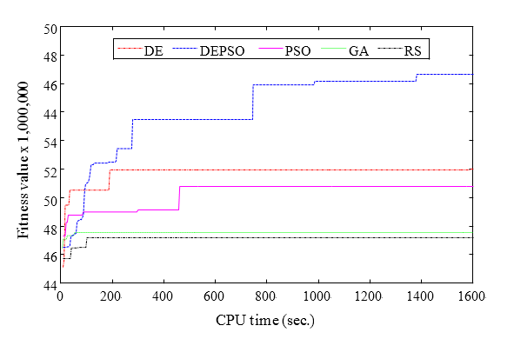
Experiment result-convergence comparison diagram
Notes:
The experiment illustrates the fitness evolution of the five algorithms. It shows that DEPSO is able to generate good solutions quickly and its convergence speed is significantly higher than the other algorithms.

Slide 7
Experiment result-Impact of stochastic demand
Notes:
The profits of the largest-scaled sub-problem generated by normal and uniform distributions of demands, and variances of it are also took into consider. ($σ=10\%$ and $σ=5\%$ of average demand are considered as high variance and middle variance, respectively). As shown in figure 9, demand variances will harm the expected profit.

Slide 8
Experiment result-technology combination strategy(DE)
Technology combination strategy
Period (t) | 0 | 1 | 2 | 3 | 4
Technology type | 1 | 1 | 1, 2 | 1, 2 | 1, 2, 3
 | 0 | 1 | 2 | 3 | 4
Purchased(1) |  | (3)* | (3, 3)* |  | (2, 2, 3)*
Rented(2) |  | (41)* | (15, 17)** | (9, 24)** | (23, 24, 19)**
Net = (1)+(2) |  | 44 | 39 | 39 | 73
Period
Capacity

Slide 9
Experiment result-technology combination strategy(DEPSO)
 | Period (t)
Period (t) | 0 | 1 | 2 | 3 | 4
Technology type (DEPSO) | (1) | (1, 2) | (1, 2) | (1, 2, 3) | (1, 2, 3)
 | Period (t)
Decisions | 0 | 1 | 2 | 3 | 4
Purchased (1) |  | (2, 3) |  | (3, 2, 4)
Rented (2) |  | (35,31) | (20, 18) | (11, 20, 19) | (19 ,27, 23)
Net = (1)+(2) |  | 71 | 45 | 59 | 75

Slide 10
Experiment result-suggested capacity and resource planning
 | DE
Period(t) | 1 | 2 | 3 | 4 | 5 | 6 | 7 | 8 | 9 | 10
1 | 52,837 | 50,769 | 56,617 | 49,300 | 50,696 | 56,029 | 58,080 | 61,708 | 64,169 | 64,147
2 | 40,894 | 50,213 | 45,873 | 63,151 | 59,653 | 55,154 | 41,479 | 52,742 | 53,462 | 49,077
3 | 47,241 | 48,097 | 49,326 | 47,617 | 50,657 | 51,686 | 58,778 | 57,750 | 50,188 | 50,118
4 | 57,372 | 48,497 | 54,872 | 54,298 | 47,581 | 53,189 | 49,173 | 51,842 | 47,932 | 51,930
 | DEPSO
Period (t) | 1 | 2 | 3 | 4 | 5 | 6 | 7 | 8 | 9 | 10
1 | 50,147 | 50,239 | 53,635 | 43,339 | 51,346 | 58,019 | 53,142 | 52,718 | 60,142 | 54,177
2 | 41,325 | 47,103 | 46,342 | 61,245 | 56,452 | 51,142 | 41,479 | 50,732 | 53,483 | 47,437
3 | 47,193 | 44,237 | 49,839 | 45,435 | 51,435 | 51,436 | 52,589 | 54,531 | 55,093 | 50,347
4 | 53 ,325 | 46,443 | 53,657 | 54,382 | 48,328 | 52,324 | 48,194 | 50,546 | 46,435 | 51,341

